Slide 1
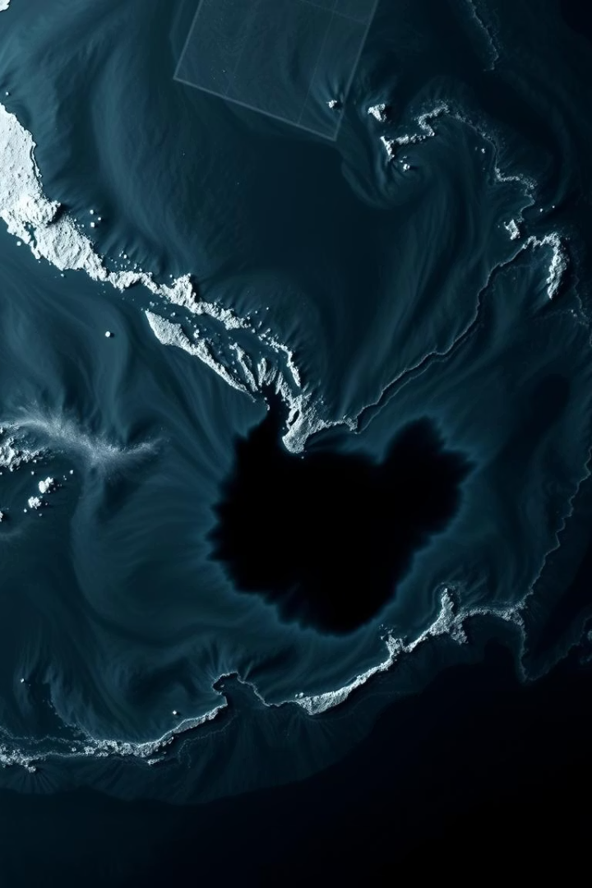
Oil Spill Detection in SAR Imagery using DeepLabV3+
Real-time marine monitoring via semantic segmentation.
Presented by:
Suryansh Singh & Harshit Rana
Bj

Slide 2
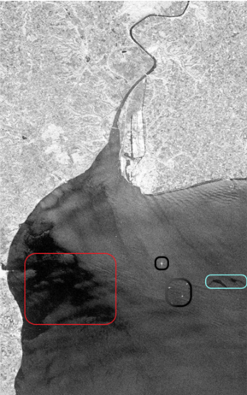
The Challenge
Marine Impact
Detection Challenges
Oil spills harm ecosystems and marine life severely.
Manual detection is slow and prone to errors.
SAR Advantages
Radar data works anytime regardless of clouds or night.

Slide 3
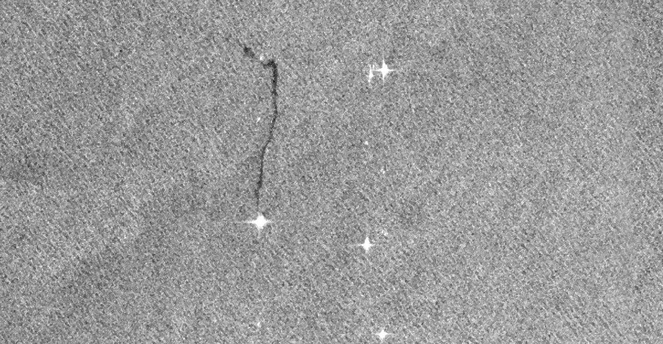
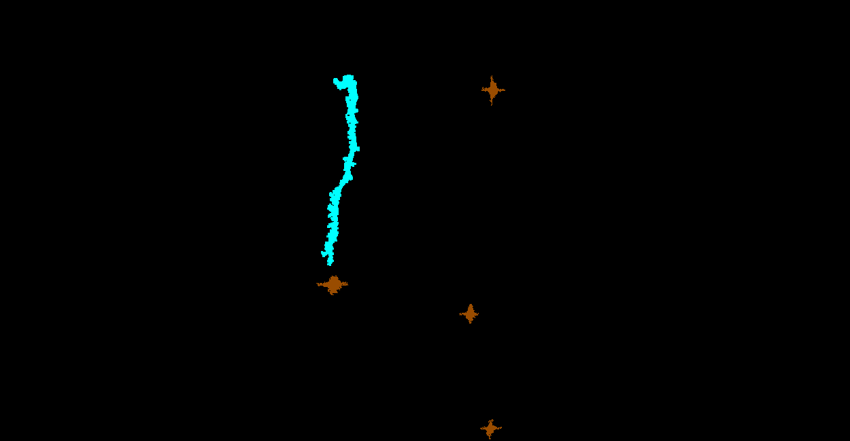
Image :
Objective & Motivation
What We Aim to Achieve
Detect and segment oil spills, ships, land, and look-alikes.
Label :
Improve pixel-level accuracy over existing models like
DeepLabV3+
Provide precise and faster decisions for agencies.
Enhancing environmental safety through deep learning applied to SAR imagery.

Slide 4
SAR Dataset Overview
Dataset Details
1002 training images, 110 test images.
Five labeled classes: Sea Surface, Oil Spill, Look-alike, Ship, Land.
Custom preprocessing: resizing, normalization, label correction.
Masked SAR images reveal detailed segmentation of critical marine features.
RGB Masks:
Black - Sea Surface
Cyan - Oil Spill
Red - Look-alike
Brown – Ship
Green - Land
RGB Values:
Black - (0, 0, 0)
Cyan - (0, 255, 255)
Red - (255, 0, 0)
Brown - (153, 76, 0)
Green - (0, 153, 0)
1-D Labels:
0 - Sea Surface
1 - Oil Spill
2 - Look-alike
3 – Ship
4 - Land

Slide 5
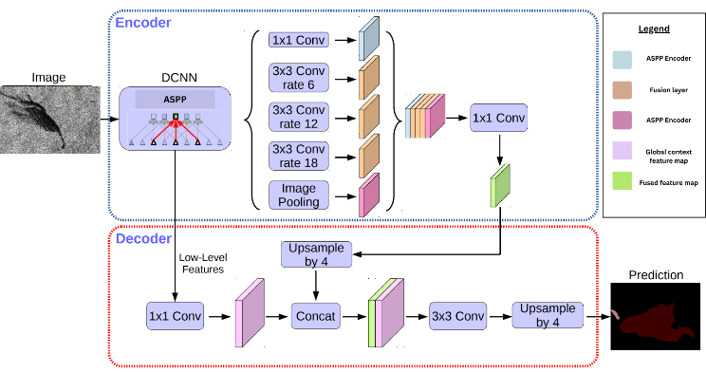
DeepLabV3+ Architecture
Key Features
ResNet backbone for powerful feature extraction.
ASPP module captures multi-scale context.
Hybrid loss combines cross entropy and dice loss.
Delivers semantic segmentation for pixel-level accuracy.

Slide 6
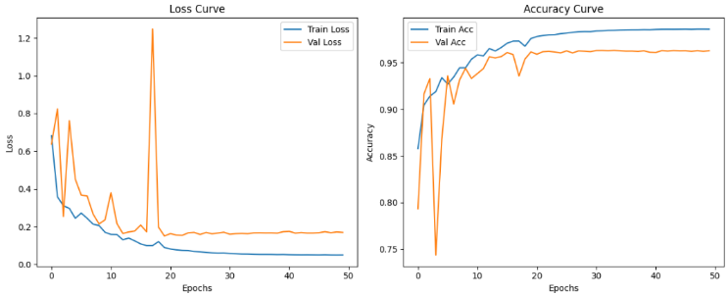
Training & Evaluation Setup
Training Details
Google Colab GPU (T4)
80 Epochs, Batch Size 4
Image Size 256×256
Evaluation Metrics
Accuracy, Precision, Recall
F1-Score, Intersection over Union (IoU)

Slide 7
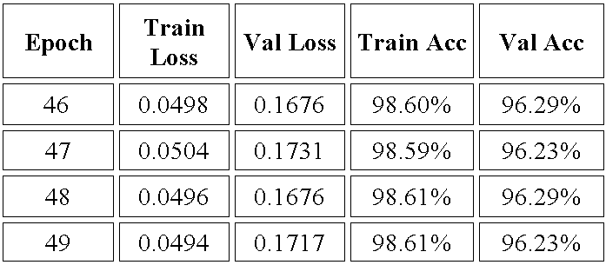

Performance Results
Visual Results
Quantitative Metrics
Predicted masks closely align with ground truth labels.
High precision and recall values
Effective distinction between oil spills and look-alike phenomena.
Superior IoU scores over baseline methods

Slide 8
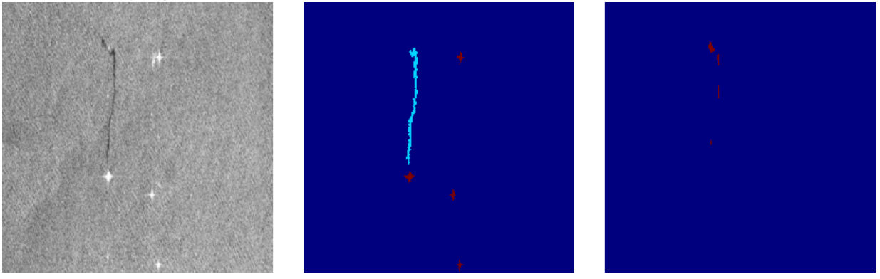
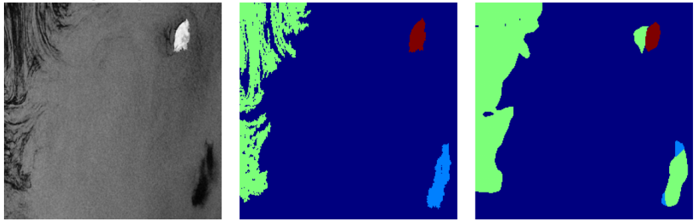
Result &Outcome
The initial result
Result after 15 epochs

Slide 9
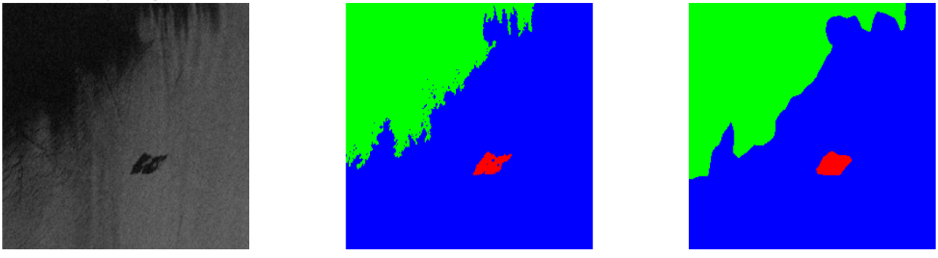

Final result

Slide 10




Future Enhancements
Diverse Data
Expand dataset across seas and seasons for robustness.
Optimization
Improve memory usage for high-resolution images.
New Targets
Detect plastic waste, chemical spills, and toxic substances.
Deployment
Real-time satellite and drone monitoring with alert systems.

Slide 11
Final Thoughts & Thanks
Summary
DeepLabV3+ offers efficient, accurate oil spill detection.
Outperforms bounding-box models in real marine environments.
Ready for scaling and real-world integration.
Dataset Link : https://mklab.iti.gr/files/oil-spill-detection-dataset.zip
Contact
Questions? Reach out at -
code4ssr@gmail.com
harshitrana1903@gmail.com

